Slide 1
customs warehouse
Instructions for the Client of booking services in the customs warehouse (for Non-Residents)
Legal regulation
Injection. Withdrawal. Chronology.
Customs Declaration
Injection-withdrawal protocol
Delivery-Acceptance
Request for the ultimate owner
Change of customs regime

Slide 2

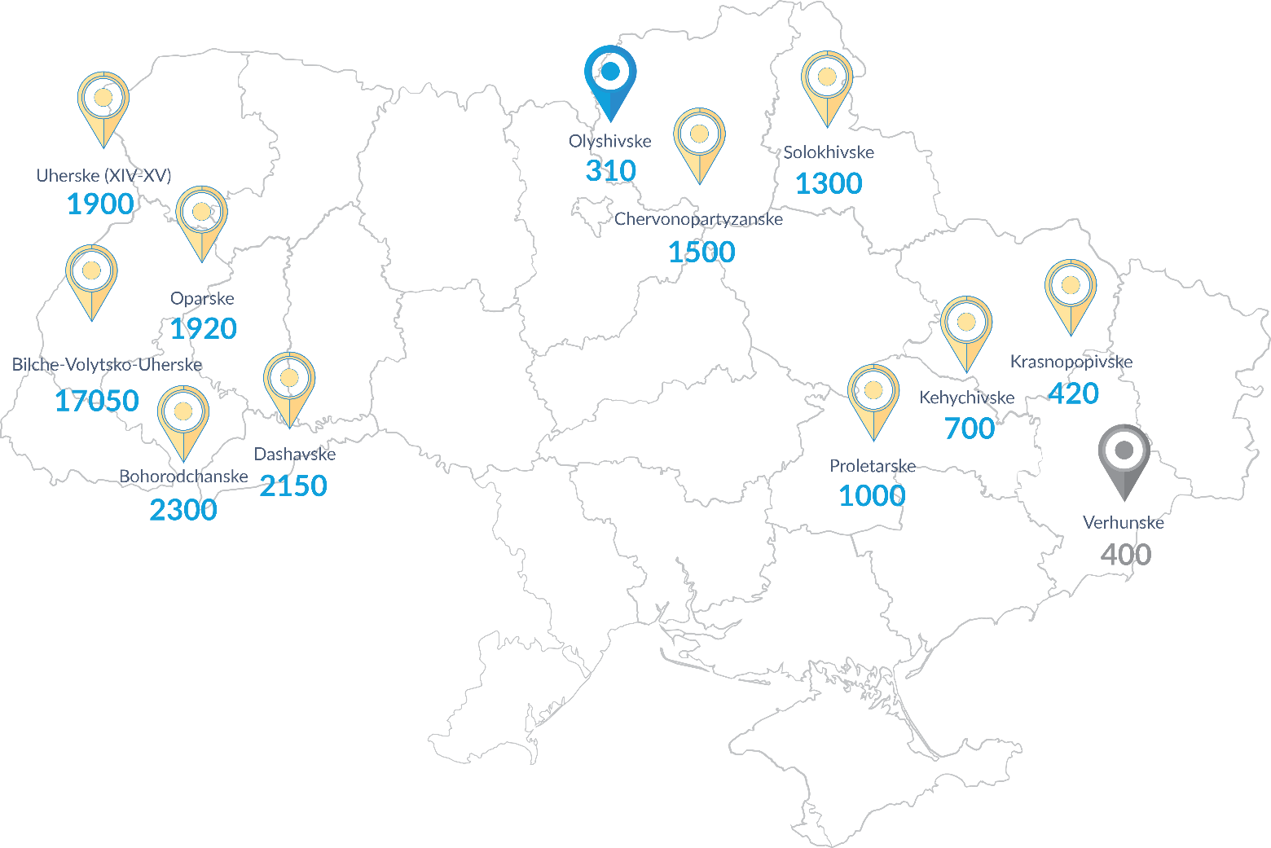


JSC Ukrtransgaz – The SSO of Ukraine
12
Storages operated by the Operator
The specified customs regime –”customs warehouse” allows Clients to store natural gas in the 10 underground gas storage facilities of Ukraine.
“Custom warehouse” – gas storage for 1095 days without taxes and customs duties with trading option on domestic and external markets.
420
10
Storages, that can operate in the regime of “customs warehouse”

Slide 3


Legal regulation of customs warehouse
The customs regime of the customs warehouse and the conditions for placing gas volumes are established in accordance with the articles of Chapter 20 of the Customs Code of Ukraine.
The storage period in the customs warehouse is 1095 days determined by Article 125 of the Customs Code of Ukraine
The transfer of ownership of natural gas volumes is defined by Article 128 of the Customs Code of Ukraine
The procedure and list of documents specified for customs declarations are regulated in accordance with the Order of the Ministry of Finance of Ukraine dated 30.05.2012 № 629 "On customs formalities on pipeline transport and power lines“
The customs regime of re-export, which regulates the export of gas from the customs warehouse outside the customs territory of Ukraine, is established in accordance with the articles of Chapter 16 of the Customs Code of Ukraine.
Resident companies in Ukraine may change the customs regime of gas volumes placed in the customs warehouse, that is to carry out "customs clearance" of imports, by paying VAT in accordance with the articles of Chapter 13 of the Customs Code of Ukraine.

Slide 4
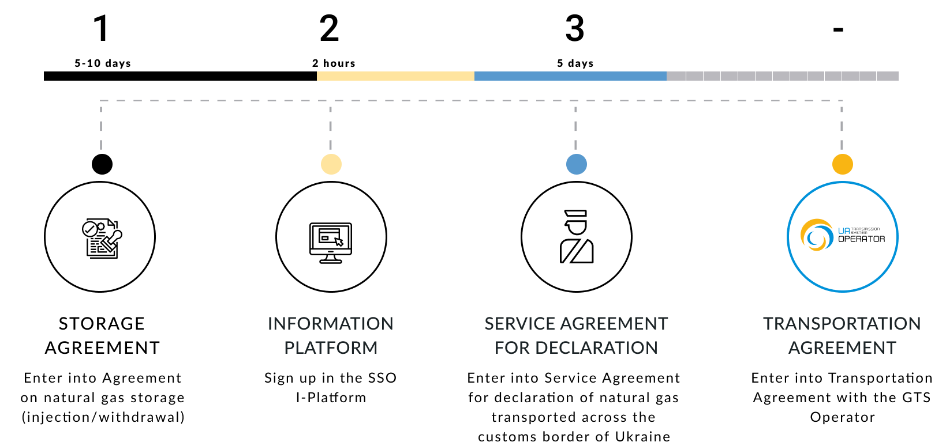
How to become a Client of the «Customs warehouse»

Slide 5
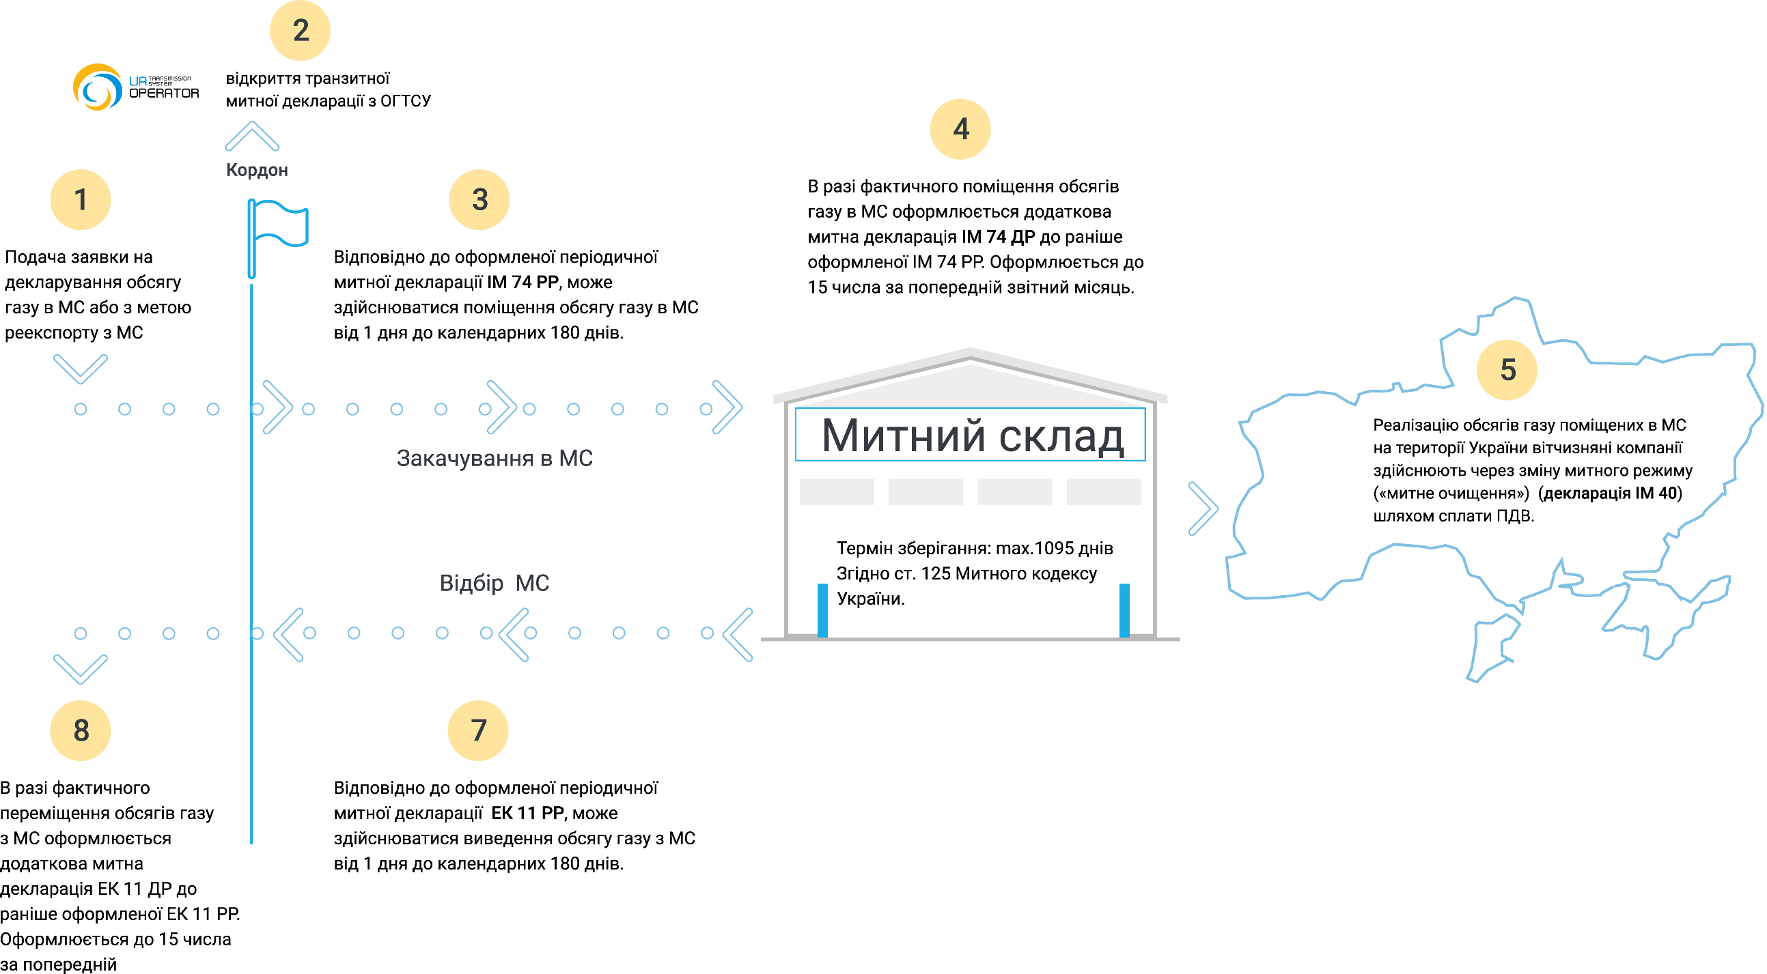
Customs warehouse working principles
issuing transit customs
Declaration (TP 81) from TSO
Border
Whether physical injection of gas to CW takes place the ACD (IM 74 ДР) shall be issued. Such an ACD shall be issued till 15-th of current month with respect to the period of injection of prior month. The ACD shall correspond with the previously issued PCD (IM 74 PP)
Submission the application for declaring the gas volume placed in CW or
for re-export purposes
According to the terms
of issued PCD (IM 74 PP) the gas
can be injected in CW
from 1 to 180 days
Customs warehouse
Customs clearance (IM 40 AA declaration) – the procedure of changing the customs regime of CW gas for the purposes of domestic consumers by means of VAT payment.
Injection to CW
Storage: max. 1095 days
According to the Article 125
of the Customs Code of Ukraine
Withdrawal from CW
7
6
Whether physical withdrawal of gas from CW takes place the ACD (ЕК 11 ДР) shall be issued. Such an ACD shall be issued till 15-th of current month with respect to the period of withdrawal of prior month. The ACD shall correspond with the previously issued PCD (EK 11 PP)
According to the terms
of issued PCD (EK 11 PP) the gas
can be withdrawn from CW
from 1 to 180 days

Slide 6
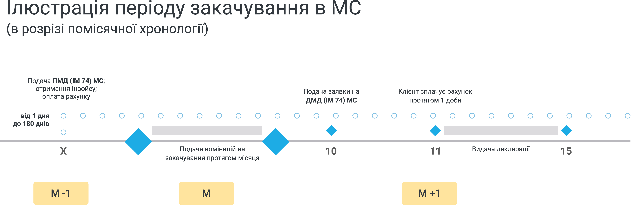
Customs warehouse injection
Chronology of CW injection
(in terms of monthly representation)
Submission of PCD (IM 74 PP);
receiving an invoice;
payment for the invoice
Submission of the application for ACD (IM 74 ДР)
Client fulfills payment of the invoice within a day
from 1 to 180 days
Submission of the nominations for injection within the month
Injection declaration issuance

Slide 7
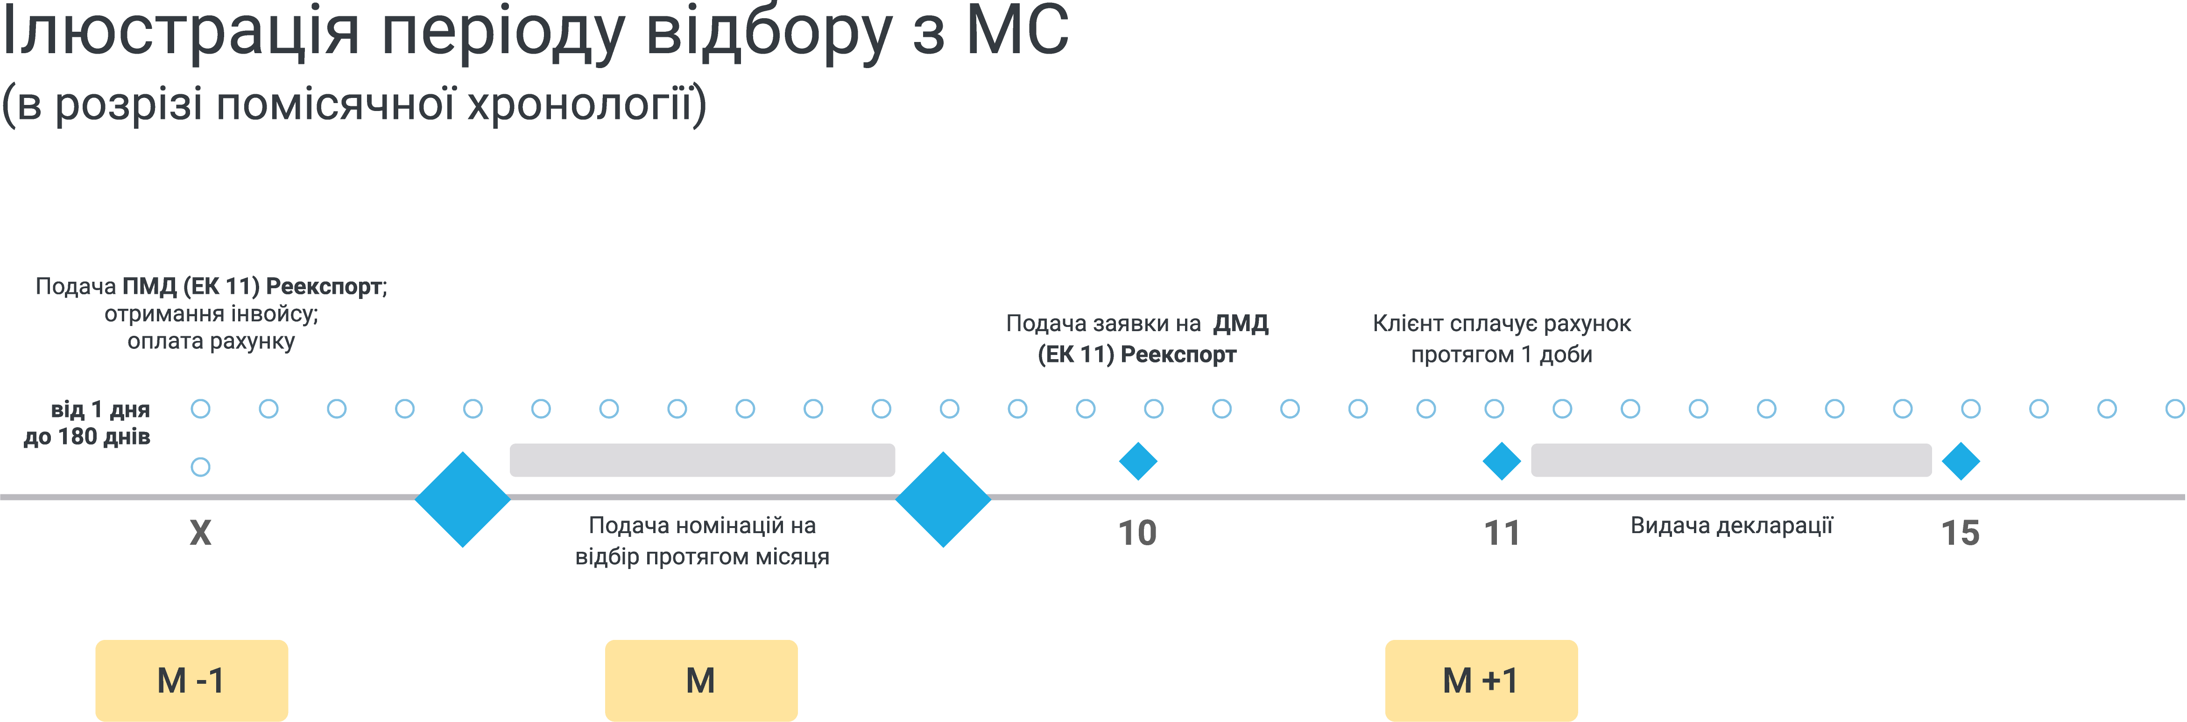
Customs warehouse withdrawal
Chronology of CW withdrawal
(in terms of monthly representation)
Submission of PCD (ЕК 11) re-export;
receiving an invoice;
payment for the invoice
Submission of the application for ACD (ЕК 11 ДР) re-export
Client fulfills payment of the invoice within a day
from 1 to 180 days
Submission of the nominations for withdrawal within the month
Withdrawal declaration issuance

Slide 8
Customs declaration of natural gas
Client
Storage System Operator
Creates application for customs declaration in I-Platform
Provides shipping documents required for customs clearance
Pays for the declaration services in advance
For additional information on customs clearance, please, contact cw@utg.ua
Approves the correctness of the submitted application for customs declaration
Checks payment for ordered services
Prepares customs declaration and sends it to the customs authority
Sends the customs declaration issued by the customs authority to the client by the I-Platform

Slide 9
The procedure of filing customs declarations for the placement and withdrawal of gas volumes in the customs warehouse
Periodic customs declaration (IM 74 PP) – is issued by the storage operator draws up the intention of the customer of storage services to place a certain amount of natural gas in the customs warehouse for a certain period from 1 day to 180 days.
Additional customs declaration (IM 74) – is issued by the gas storage operator in accordance with the periodic customs declaration (IM 74 PP), which is evidence of the actual volume of natural gas placed in the customs warehouse with a storage period of up to 1095 days and the possibility of customer of storage services to sell volume to other entities. The additional customs declaration number (23UA903020111111U1) is the consignment track number.
Periodic customs declaration (EC 11) Re-export - is issued by the gas storage operator and any declarant on the territory of Ukraine draws up the intention of the customer of storage services to withdraw a certain amount of natural gas from the customs territory of Ukraine, in particular the customs warehouse within a certain period from 1 day to 180 days.
Additional customs declaration (EC 11) Re-export - is issued by the gas storage operator and any declarant on the territory of Ukraine, which is evidence of the actual amount of natural gas exported from the customs territory of Ukraine.

Slide 10
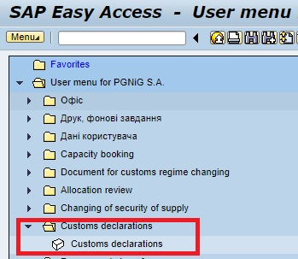

Application for customs declaration 0.1
1. Log in to the I-Platform under your login and password. Find the “Customs Declaration transactions”.
2. In the selected transaction in the right corner of the menu, click on "Create applicat"

Slide 11
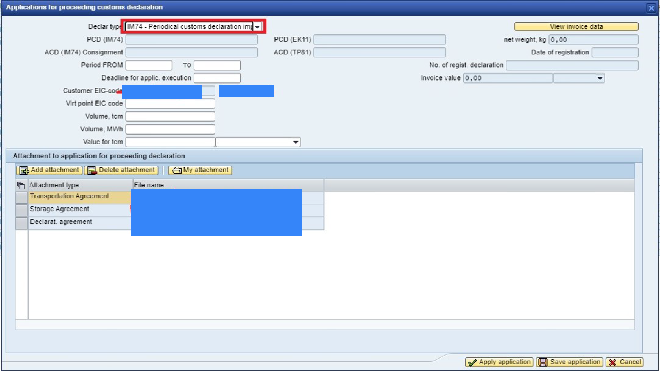
Application for customs declaration 0.2
3. Algorithm of application submission:
Choose the appropriate type of declaration;
Fill in the period of validity of the declaration and the deadline for execution of the application;
The code of the virtual point, Volume and its cost per thousand kWt*h - is filled in according to business needs;
Shipping documents certifying the declared amount of gas are attached to the application
When creating an application, the key role is the correctness of filling in the columns on the declared amount of natural gas in accordance with the properly executed shipping documents.

Slide 12
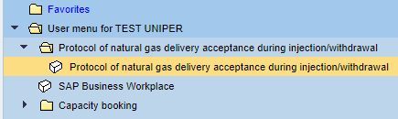
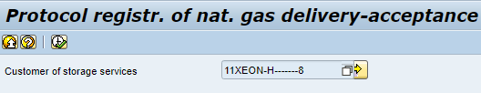

Injection/withdrawal protocol registration (1/4)
Authorize I-Platform using login and password.
Enter the transaction Protocol of natural gas delivery acceptance during injection/withdrawal
2. Press “clock” button
3. Select the required protocol

Slide 13
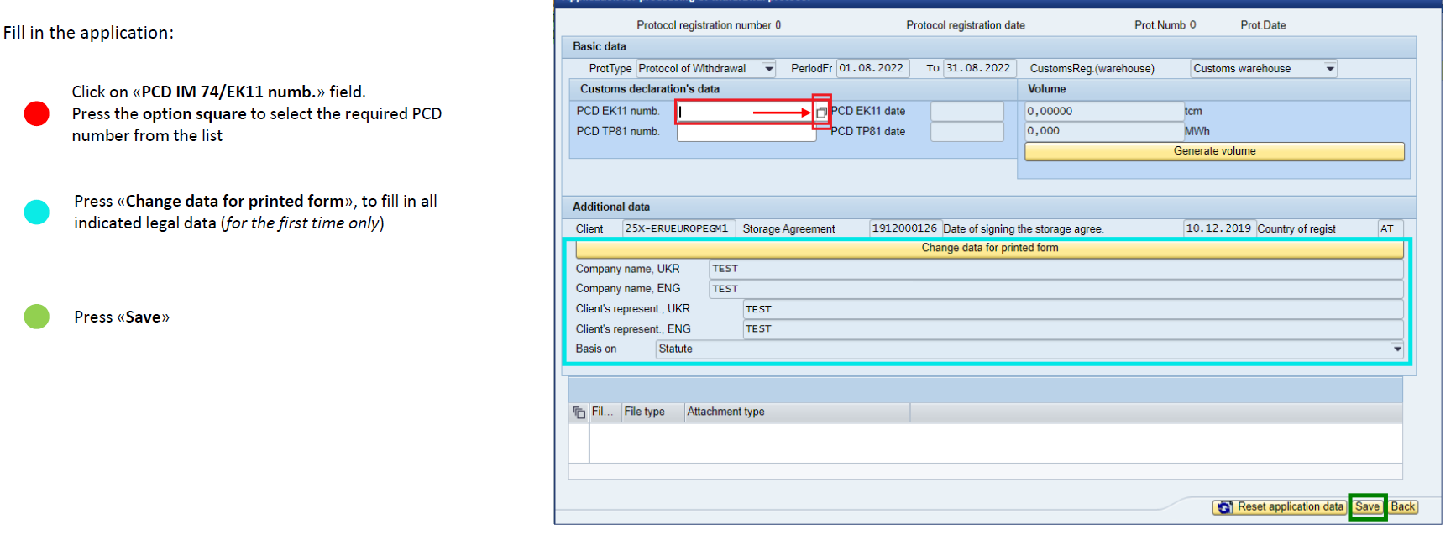
Формування акту при відборі/закачуванні газу
Injection/withdrawal protocol registration (2/4)
4. Fill out the required data:
Generate volume

Slide 14


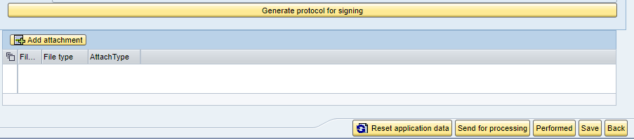
Формування акту при відборі/закачуванні газу
Injection/withdrawal protocol registration (3/4)
Status of the document shall be changed to “Saved”
5. Enter the created document and press “Generate volume”
6. Press «Calculate volume» after «Done»
7.:
Press «Generate protocol for signing»
The system shall download generated protocol to Client’s file system
to sign and seal it. Use «Save a copy to the native file system»
Press «Add attachment», to upload signed protocol
Press «Send for processing»

Slide 15


Формування акту при відборі/закачуванні газу
Injection/withdrawal protocol registration (4/4)
Press «Import from native file system»
8. Status of the document changed to «Signed by the client»
9. After SSO signing status shall be - «Signed by the client and SSO»
10. After TSO signing status shall be - «Signed by the client, SSO and TSO»
PDF document will be sent to TSO side for signing - automatically.
After TSO protocol signing the application for additional customs declaration will be created within the corresponding functionality of I-Platform.

Slide 16


Delivery-acceptance of natural gas within USG
Client: Submits Trading Notification(TN) in I-Platform.
UGS: Confirms Trading Notification
3. Client: For further customs clearance (residents only), for non-residents and residents is also applicable for reexport purposes - the Client sends signed Approval certificate to cw@utg.ua and apply for the gas ownership reference.
UGS: CW division sends gas ownership reference to the Client.
2. Client: Downloads the Approval certificate within I-Platform in the “Report on Trading Notifications” transaction.
.

Slide 17
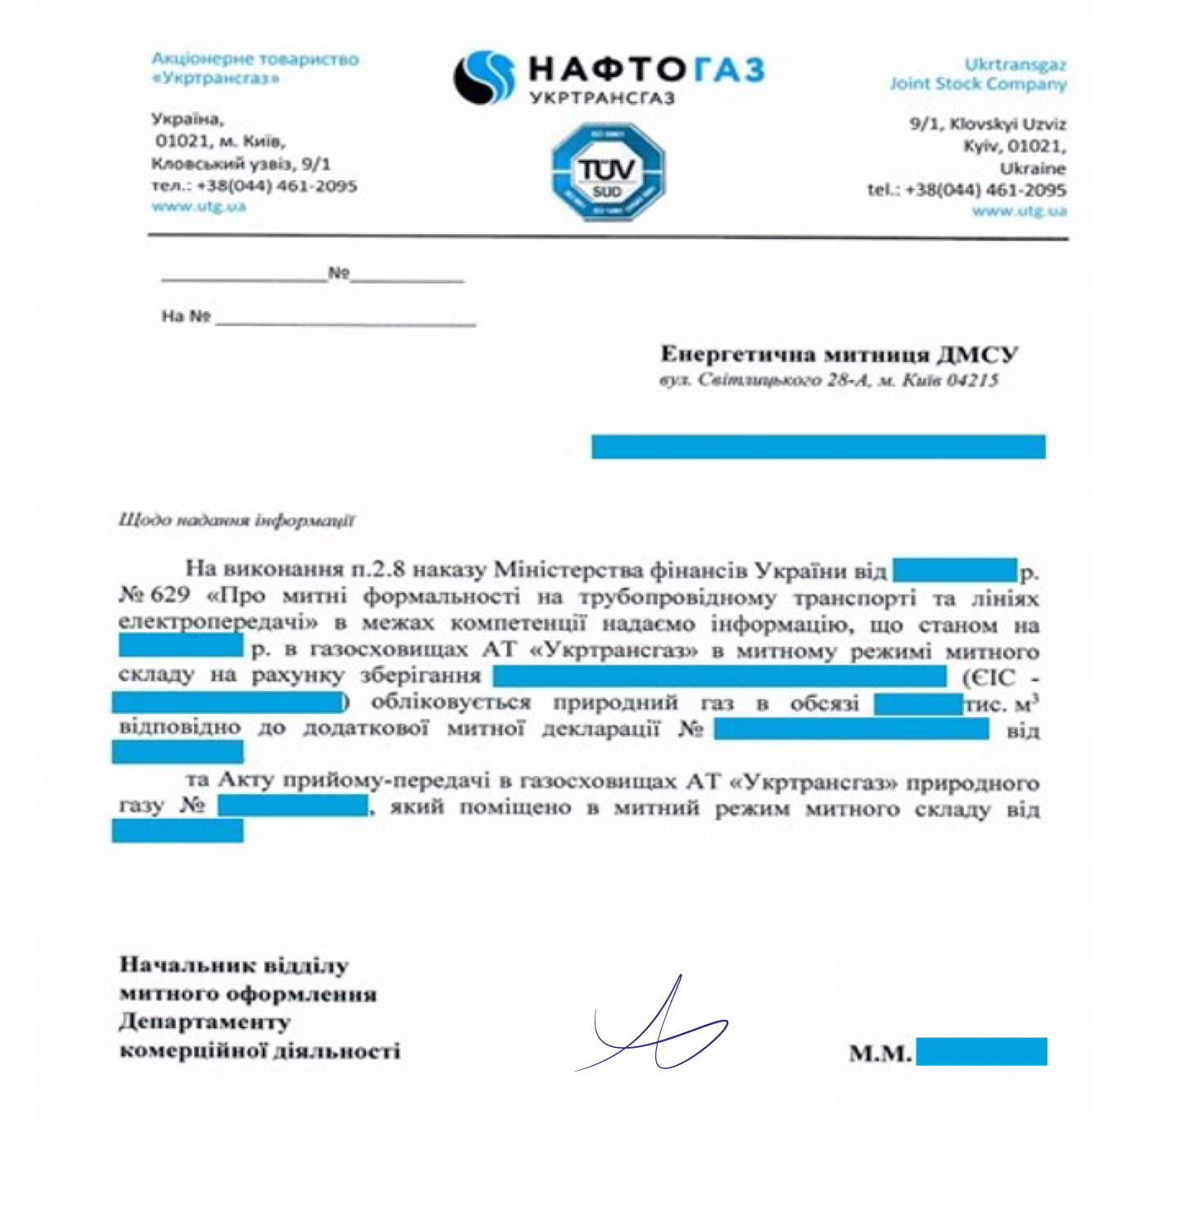
Templates: request for the ultimate owner.
Certificate on ultimate owner.
request for the ultimate owner
certificate on ultimate owner
JSC "Ukrtransgaz"
Dear Oleksandr Sydorchuk
Pursuant to paragraph 2.8 of the order of the Ministry of Finance of Ukraine № 629 of 30.05.2012 (name of the company, EIC-code) requests information with confirmation of the ultimate owner of the gas received in accordance with the approval certificate No.____________ dd.________________ (approval certificate copy is attached), and placed in the customs warehouse in accordance with the additional customs declaration No. (additional customs declaration IM 11 ДР) _______________ dd. ____________________.

Slide 18
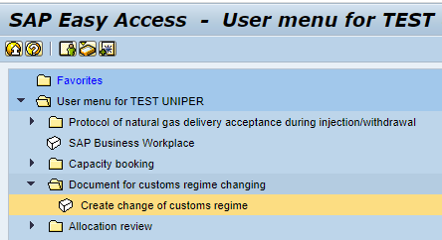
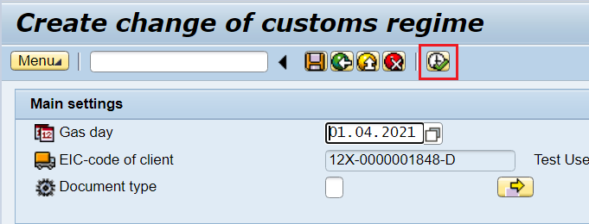
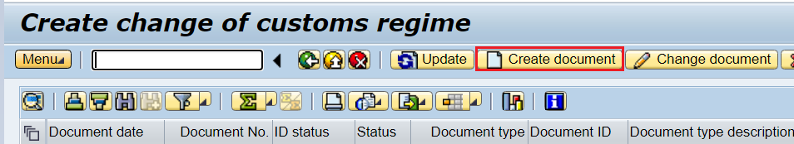
Change of customs regime. Short-Haul - CW
1. Enter the I-Platform using Login and Password.
Select the transaction “Create change of customs regime”.
2. Select current date and press ‘”clock button”.
3. Press the button “Create document”

Slide 19
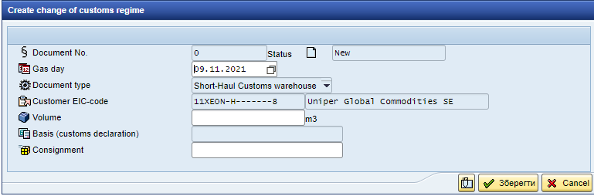
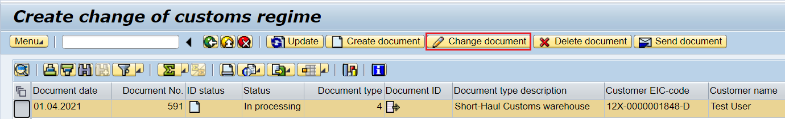
Change of customs regime. Short-Haul - CW
Gas day – the date of Short -Haul payment to the TSO shall be indicated.
Document type – for non-residents shall be used exclusively the Document type Short-haul – Customs warehouse;
Volume – volume of natural gas that shall be changed with respect to the customs regime;
Basis (customs declaration) – for this type of document is not applicable (leave empty);
Consignment – shall be selected from the list (IM 74 ДР).
After creation of the Document it shall be line-selected and pressed button Send document.
As soon as the Operator will confirm the Document, the Status of the Document will change from “In processing” to “Confirmed”

Slide 20
Thank you
front-office@utg.ua
cw@utg.ua

